Slide 1
Object Detection Project
We AI training Name: Amir Fawzey Victor

Slide 2
Object Detection Project overview
Project’s goal: Detect (People, bags , cars and busses) within a given set of images extracted from a video.
Roboflow was used to assign and label the dataset.
Used Google Colab to run the code and train the model.
Extracted model behavior and summary from the code and Roboflow.

Slide 3
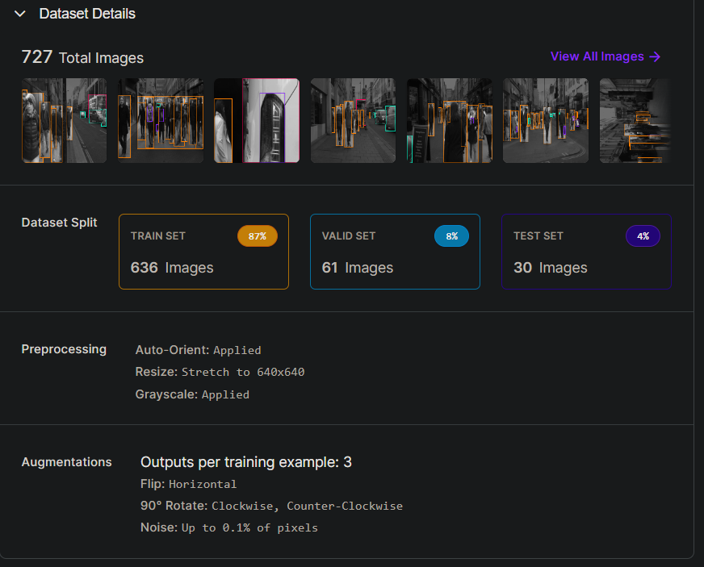
Dataset
Dataset Used:

Slide 4

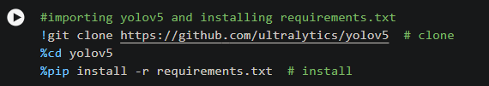


Importing the needed libraries
Importing the necessary libraries such as:
ultralytics
yolov5
roboflow
torch
Os
IPython.display

Slide 5
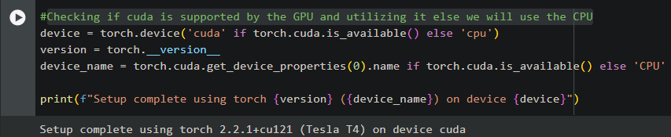
Checking hardware
Checking if CUDA is supported by the GPU and utilizing it else we will use the CPU

Slide 6
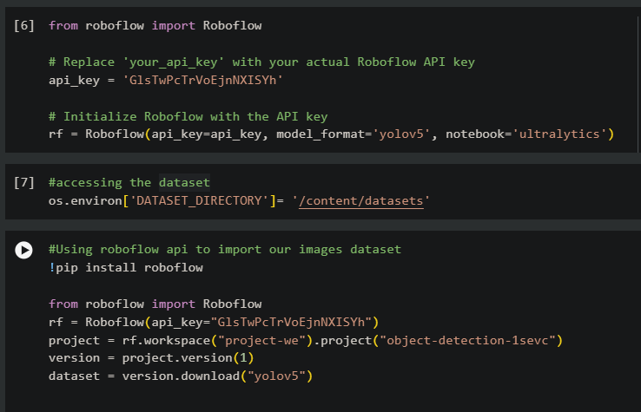
Importing the dataset from Roboflow using the assigned API key.
Initialize Roboflow with the API key.
Accessing and downloading the dataset.
And Using Roboflow api to import our images dataset.

Slide 7
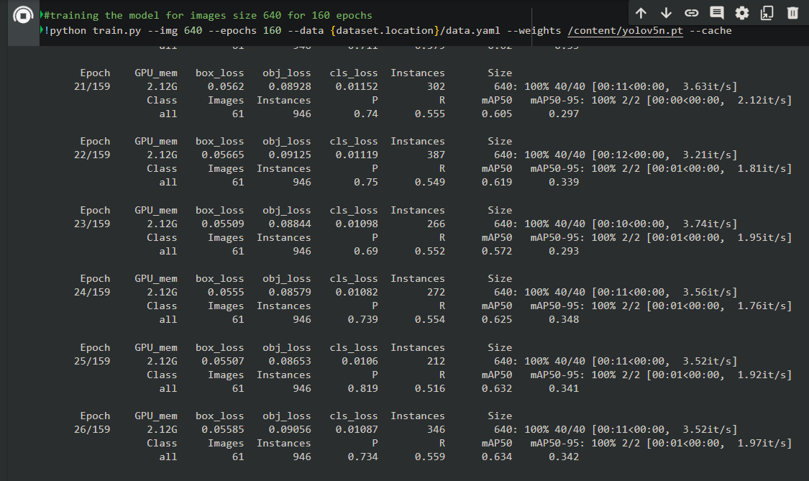
Training the Model
Training the model for images size 640 for 160 epochs.

Slide 8
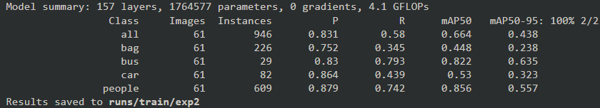
Model summery
Achieved model Stats(Precision, recall, mAP):
Precision: 83.1%.
Recall: 58%.
mAP: 66%.
From this stats we see the model performance for each object(Car, Bus, Bag, People)

Slide 9
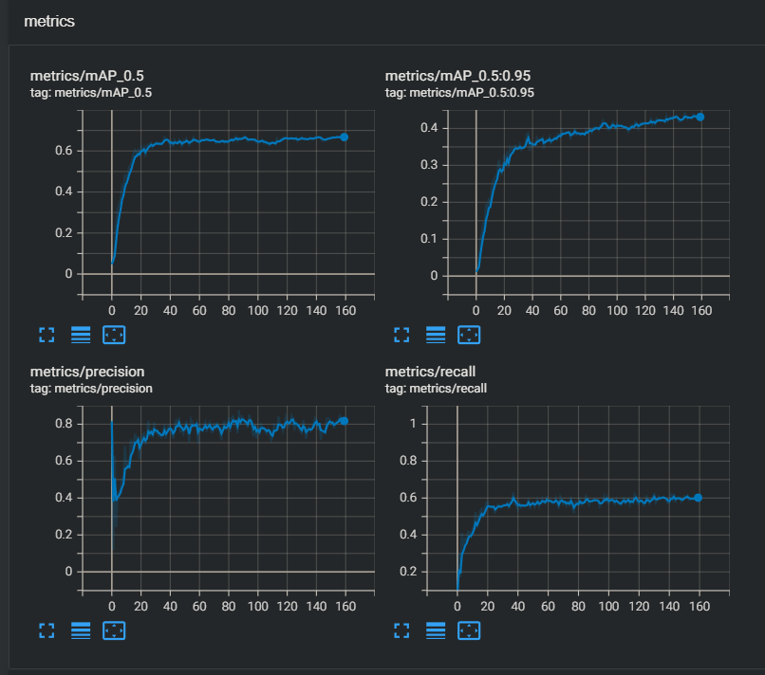
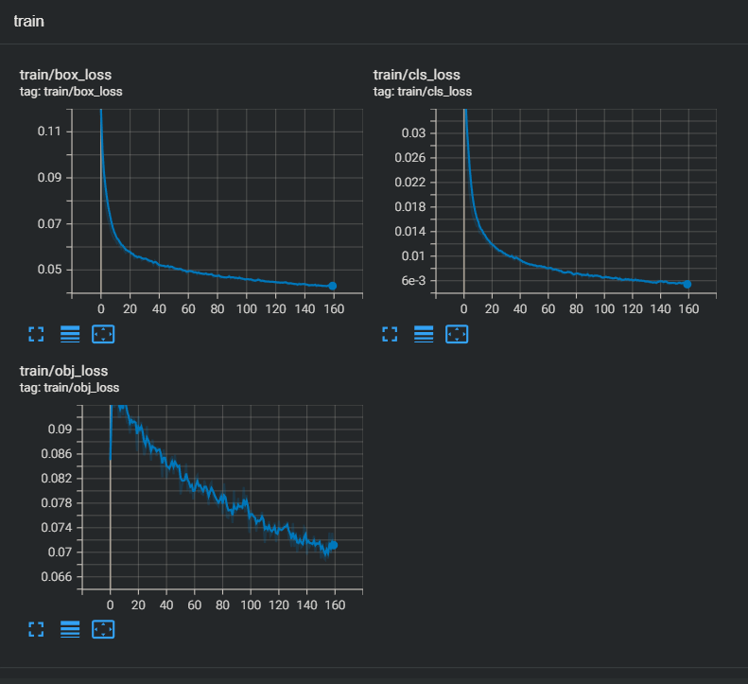
Model Metrics

Slide 10
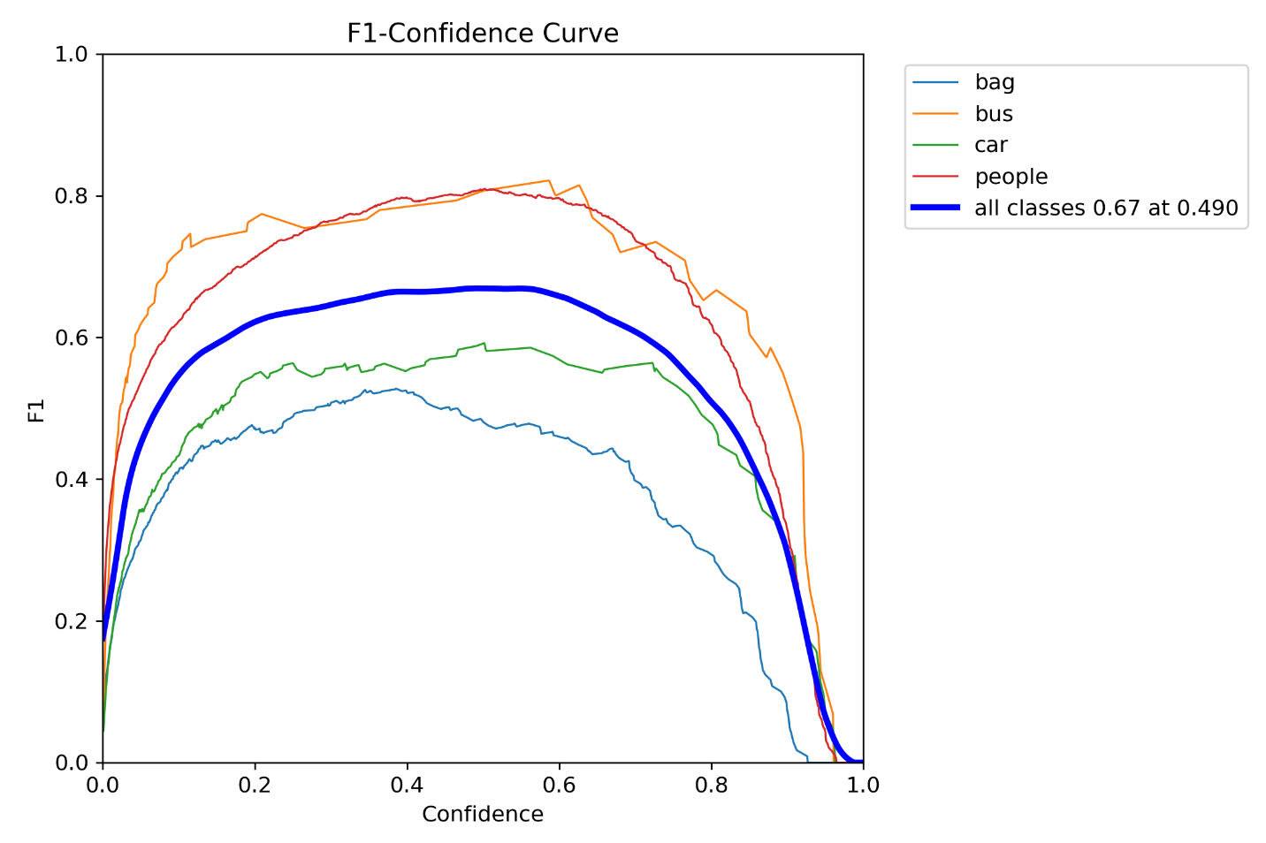
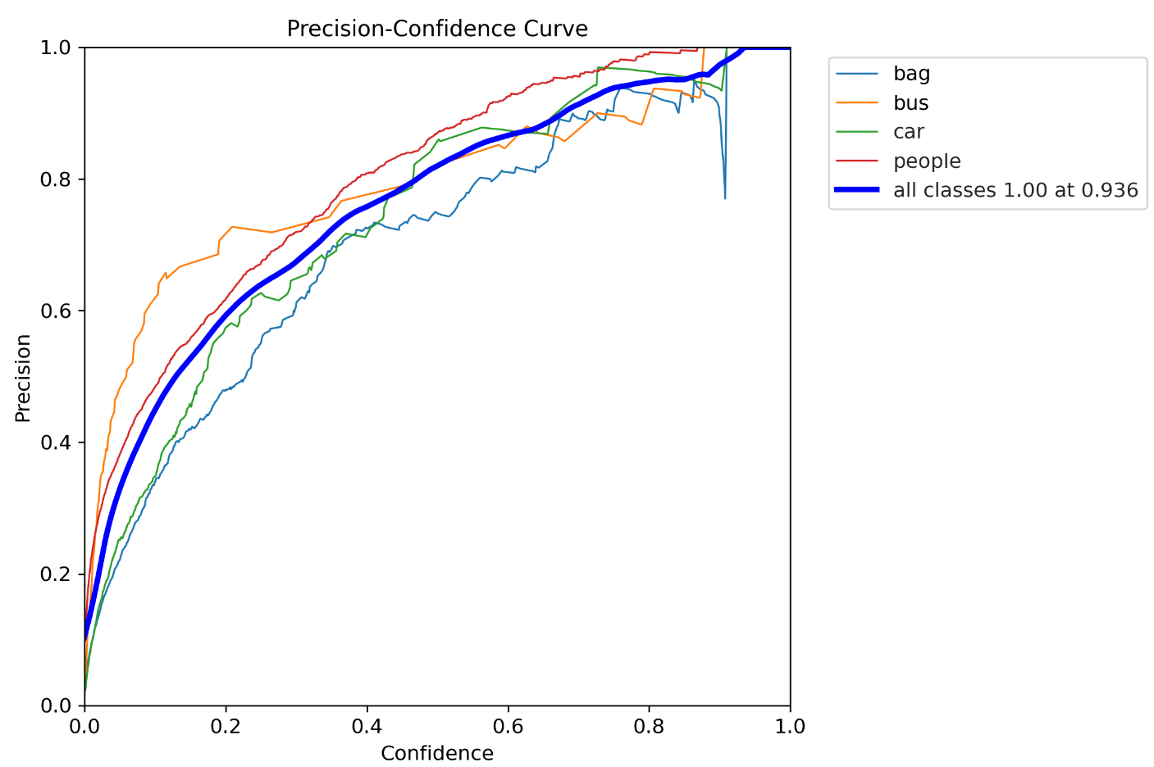
Model Metrics: F1 and P Curves

Slide 11
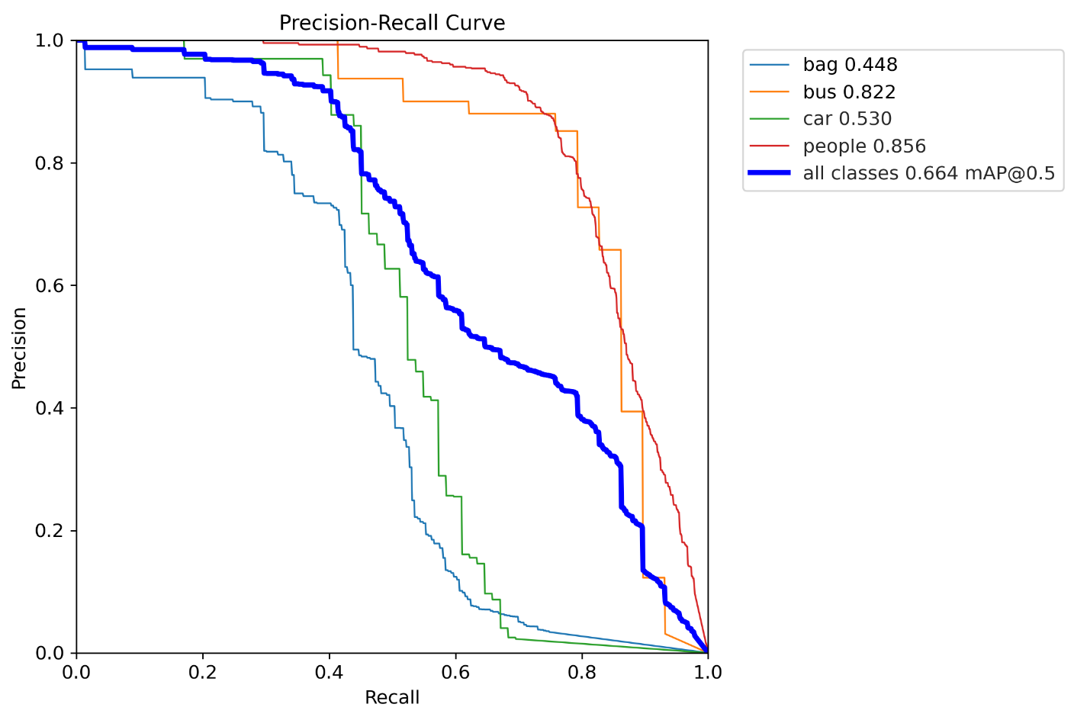
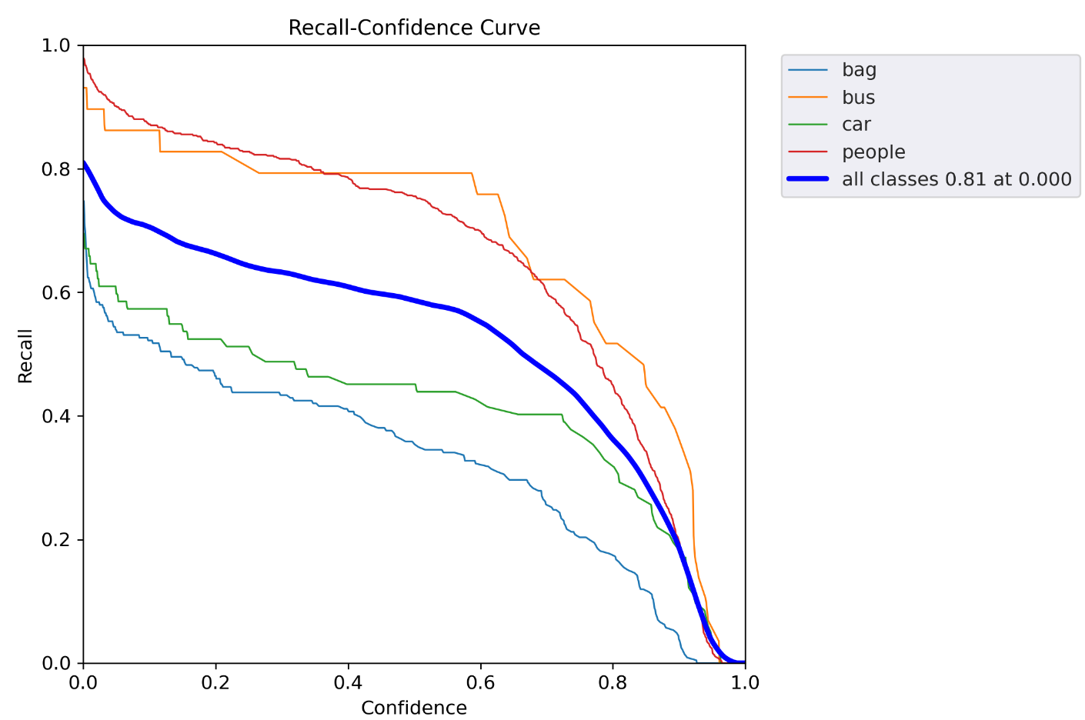
Model Metrics: Precision and Recall Curves

Slide 12
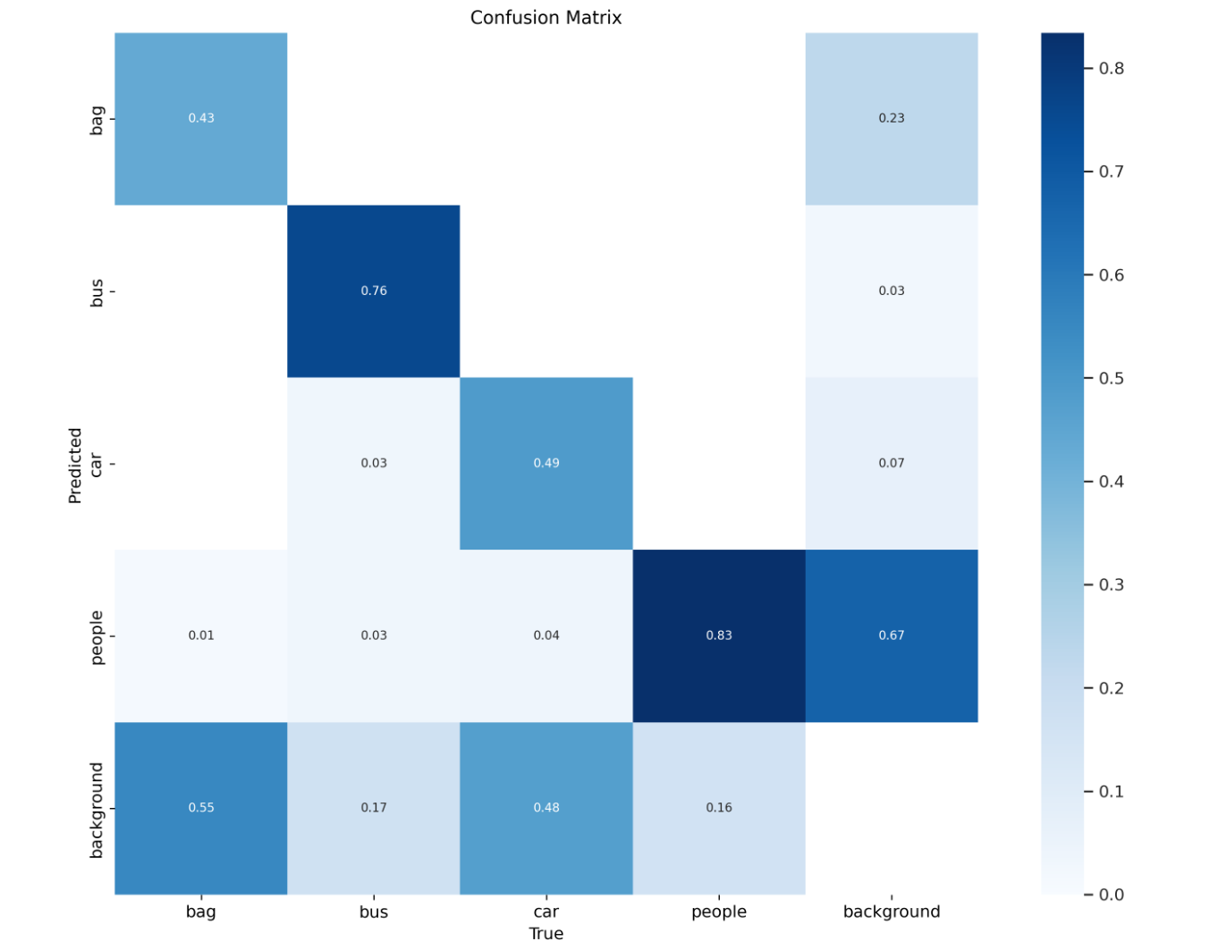
Model Metrics: Confusion Matrix

Slide 13
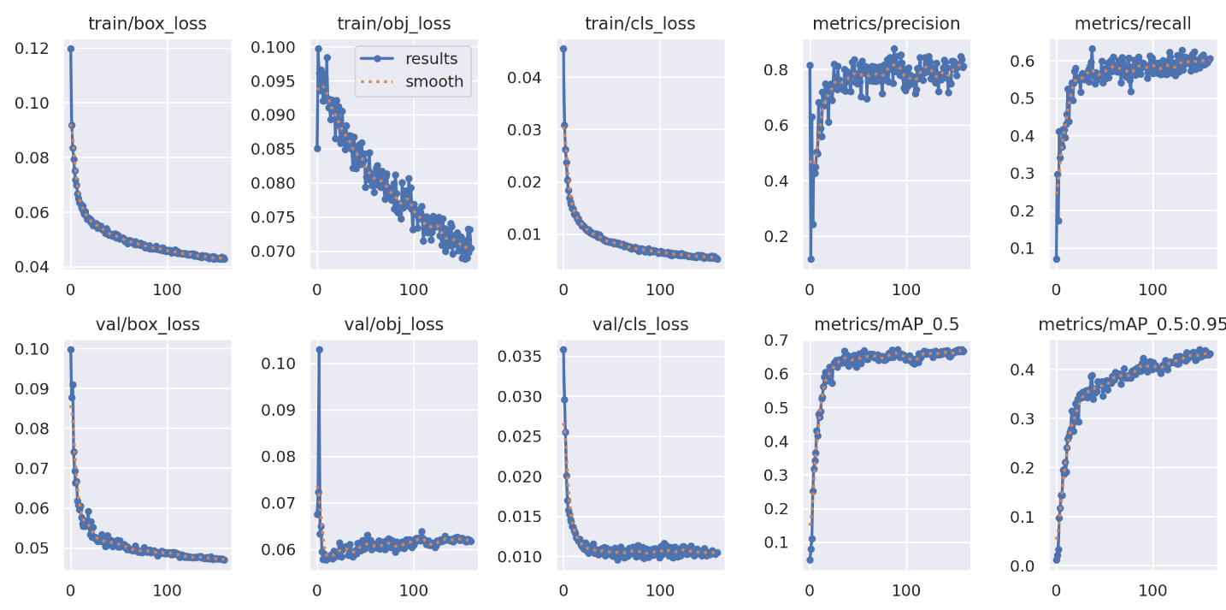
Model Metrics: Results

Slide 14
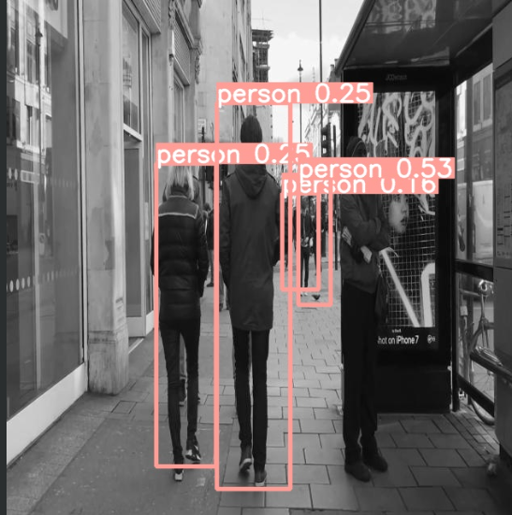
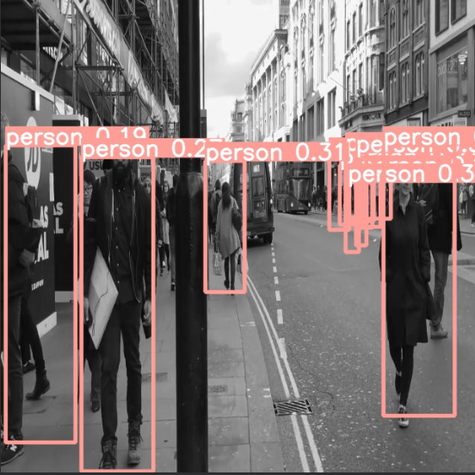
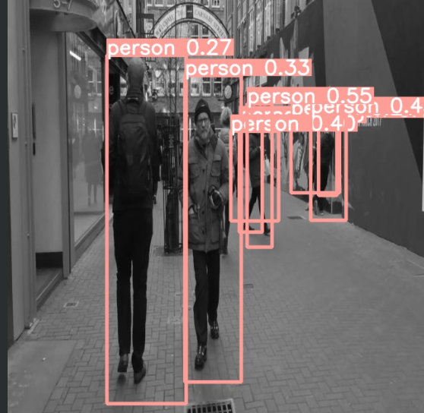
Model Metrics: Sample test Images results

Slide 15
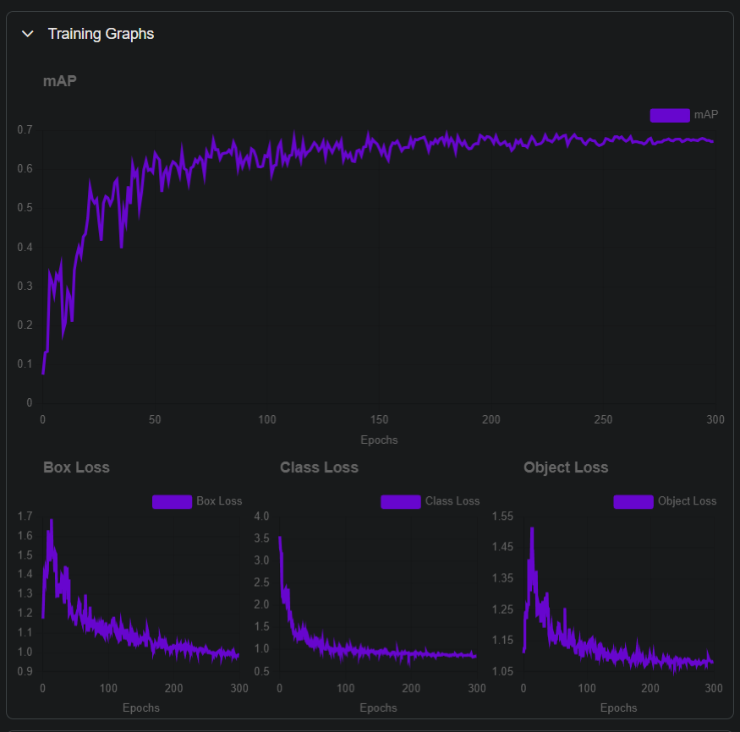
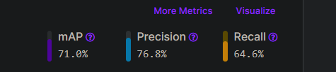
Roboflow Model Summary

Slide 16
Final conclusion
The model performance is good however if trained on a larger dataset and optimized on better number of epochs the model will achieve better results
The model final performance:
Precision: 83.1%.
Recall: 58%.
mAP: 66%.

